Slide 1
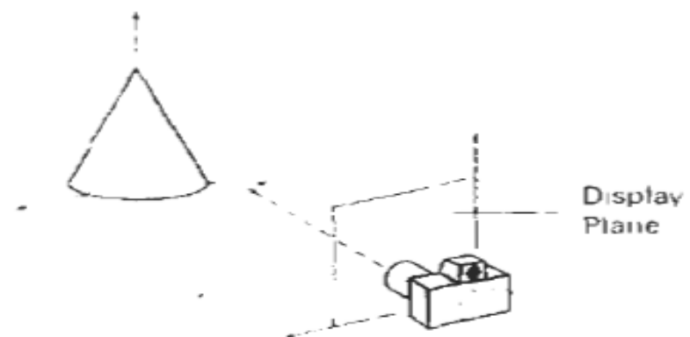
3D Viewing
2D: specify a window on 2D world and a view port on 2D view surface
Objects in world are clipped against window and are then transformed into view port for display.
Added complexity caused by
i. added dimension
ii. display devise are only 2D
Solution is accomplished by introducing projections that transform 3D objects onto 2D plane

Slide 2
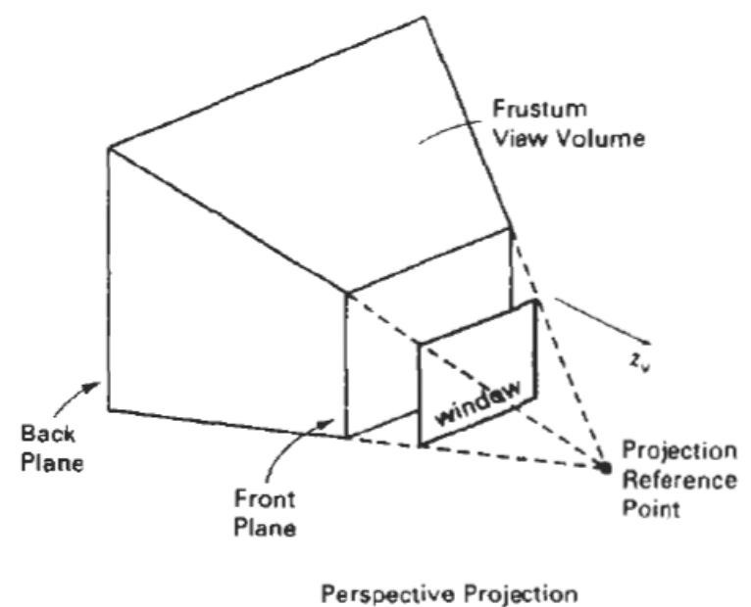
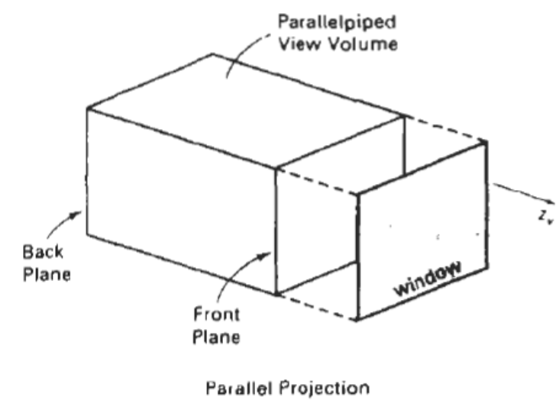
3D Viewing
3D: Specify view volume (only objects within view volume appear in display on output device others are clipped from display) in world, projection onto projection plane and view port on view surface
Objects in 3D world are clipped against 3D view volume and are then projected

Slide 3
Projections
The process of transforming points in coordinate system of dimension ‘n’ into points in a coordinate system of dimension less than ‘n’ is called projection.
Projection is required as the display device is a 2D plane and objects are modeled in 3D space
2 Types of Projections
distinction is in relation of center of projection to
projection plane
ii. if the distance from one to other is finite then projection is
perspective
iii. if the distance is infinite then projection is parallel.

Slide 4
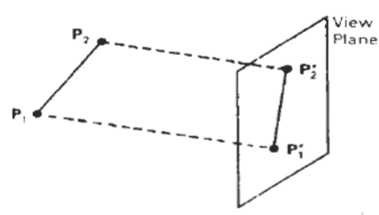
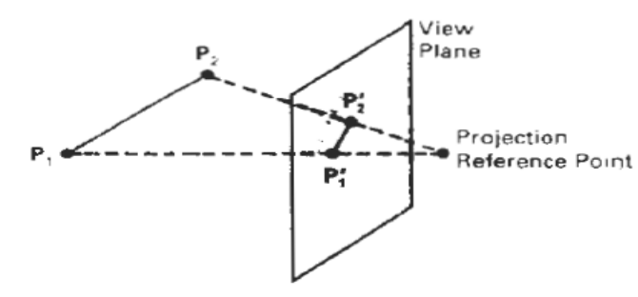
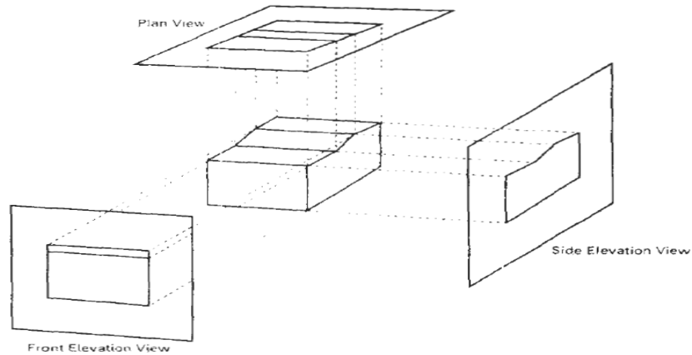
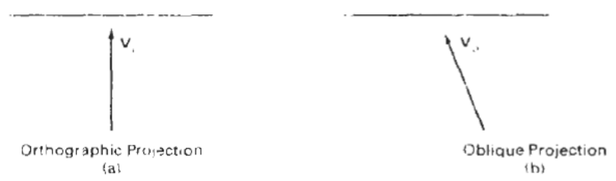
Projections
Parallel
Coordinate positions are transformed to the view plane along parallel
lines
Preserves relative proportions of objects so that accurate views of various sides of an object are obtained but doesn’t give realistic representation of the 3D object.
Can be used for exact measurements so parallel lines remain parallel.

Slide 5
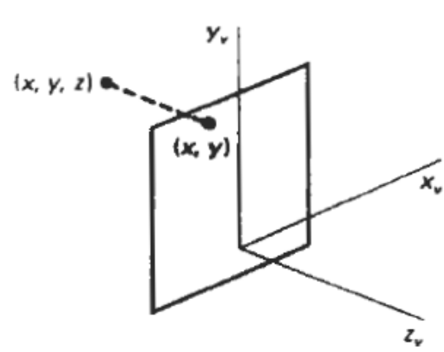
Orthographic Parallel Projection
Projection is perpendicular to view plane
Used to produce the front, side and top views of an object. Front, side and rear orthographic projections of an object are called elevations
Views that display more than one face of an object are
called axonometric orthographic projections.
Transformation Equations
If view plane is placed at position z_{vp} along z_{v} axis
then any point (x,y,z) is transformed to projection as
x’ = x , y’ = y z’ = 0
z value is preserved for depth information needed (visible surface detection).
1 0 0 0 x
0 1 0 0 y
= 0 0 0 0 z
0 0 0 1 1
x’
y’
Z’
1

Slide 6
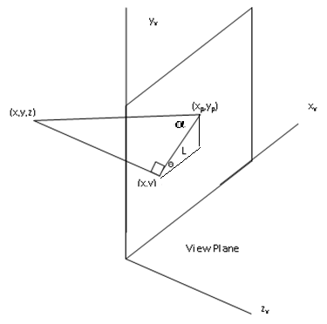
Oblique Parallel Projection
Obtained by projecting points along parallel lines that are not perpendicular to projection plane.
Often specified with two angles θ and α
Point (x ,y ,z) is projected to position(x_{p} , y_{p} ) on the view plane
Orthographic projection coordinates on the plane are (x,y).
Oblique projection line from (x,y,z) to (x_{p} , y_{p} ) makes an angle α with the line on the projection plane that joins (x_{p} , y_{p} ) and (x , y)
This line of length L is at an angle θ with the horizontal direction in the projection plane.
Expressing projection coordinates in terms of x,y,L and θ as
cosθ = (x_{p} - x)/ L x_{p} = x + Lcosθ
sinθ = (y_{p} - y)/ L y_{p} = y + Lsinθ
L depends on the angle α and z coordinate of point to
be projected
tan α = z/L
Oblique
Ortho

Slide 7
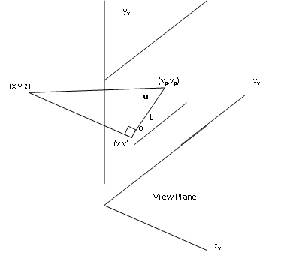
Oblique Parallel Projection
x_{p} = x + Lcosθ
y_{p} = y + Lsinθ
L = z/tan α
= zL₁ L₁ is the inverse of tanα
so the oblique projection equations are
x_{p} = x + z. L₁cosθ
y_{p} = y + z. L₁sinθ
The transformation matrix for producing any parallel projection onto the x_{v} y_{v} plane can be written as
1 0 L₁cosθ 0
0 1 L₁sinθ 0
= 0 0 0 0
0 0 0 1
Orthographic projection is obtained when L₁ = 0
(occurs at projection angle α of 90*)
Oblique projection is obtained with non zero values for L_{1.}
X_{p}
Y_{p}
Z_{p}
1
X
Y
Z
1

Slide 8
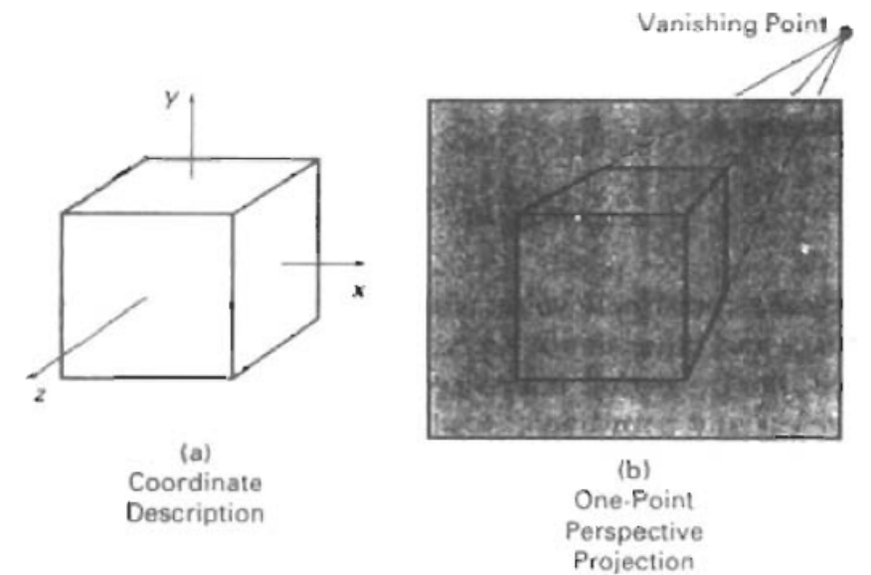
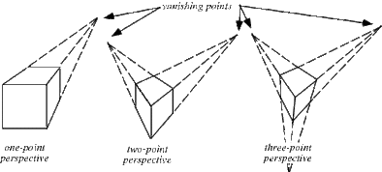
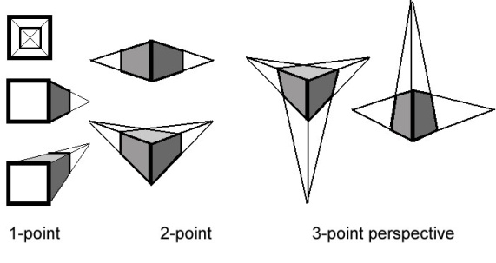
Perspective Projection

Slide 9
Perspective Projection
Method for generating a view of a three-dimensional scene by projecting points to the display plane along converging paths.
Objects farther from viewing position are displayed smaller than objects of the same size that are nearer to the viewing position
Lines in a scene that are not parallel to the display plane are projected into converging lines.
Scenes displayed appear more realistic, just the way that eyes and camera lens form images.

Slide 10

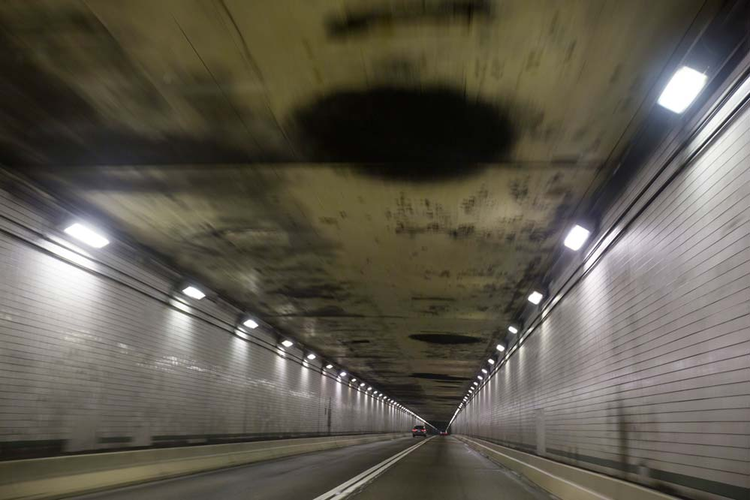
Perspective Projection

Slide 11

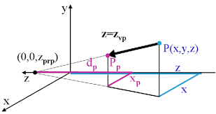
Perspective Projection
Lines appear to converge to a distant point in the background, distant objects appear smaller than objects closer to the viewing position.
To obtain a perspective projection of a three-dimensional object, transform points along projection lines that meet at the projection reference point.
Suppose the perspective reference point is set at position z_{prp} along the z_{v}, axis, and the view plane is placed at z_{vp} .
Equations describing coordinate positions along this perspective projection line in parametric form as

Slide 12
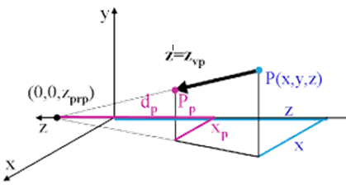

Perspective Projection
Parameter ‘u’ takes values from 0 to 1, and coordinate position (x', y', z') represents any point along the projection line.
When u = 0, we are at position P = (x, y, z)
At the other end of the line, u = 1 and we have the projection reference point coordinates (0,0, z_{prp}) On the view plane, z' = z_{vp} , and we can solve the z' equation for parameter u at this position along the projection line:
Substituting this value of u into the equations for x' and y', we obtain the perspective transformation equations
z’ - z = -(z - zprp)u u =(zvp - z)/(zprp-z)
x’ = x – xu = x – x.zvp + xz/(zprp-z)
= (x.zprp - xz – x.zvp + xz )/(zprp-z)
x’ = x (zprp – zvp)/(zprp - z)
y’ = y (zprp – zvp)/(zprp - z)

Slide 13
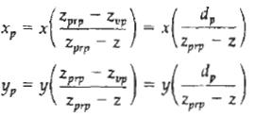
Perspective Projection
Parameter ‘u’ takes values from 0 to 1, and coordinate position (x', y', z') represents any point along the projection line.
When u = 0, we are at position P = (x, y, z)
At the other end of the line, u = 1 and we have the projection reference point coordinates (0,0, z_{prp}) On the view plane, z' = z_{vp} , and we can solve the z' equation for parameter u at this position along the projection line:
Substituting this value of u into the equations for x' and y', we obtain the perspective transformation equations as
x’ = x.(zprp -zvp)/(zprp – z)
y’ = y.(zprp -zvp)/(zprp – z)
where, d_{p} = z_{prp} - z_{vp} is the distance of the view plane from the projection reference point.

Slide 14
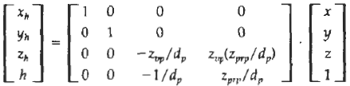

Perspective Projection
Using a three-dimensional homogeneous-coordinate representation, we can write the perspective projection transformation in matrix form as
In this representation, the homogeneous factor is
and the projection coordinates on the view plane are calculated from the homogeneous coordinates as

Slide 15
Perspective Projection
Find the perspective projection of a tetrahedron A(3,4,0), B(1,0,4), C(2,0,5), D(4,0,3)onto a projection plane situated at 0. The center of projection should be located at -5.
x’ = x.(zprp -zvp)/(zprp – z)
y’ = y.(zprp -zvp)/(zprp – z)
where, d_{p} = z_{prp} - z_{vp} is the distance of the view plane from the projection reference point.

